Slide 1
Yubi No Jesucha
Done by:- Harsh.S.Kadam
V.Naveen Kumar
T.Hanish Kumar
R.Rahul Naik

Slide 2
Abstract
This paper proposes a way to control the position of the cursor with the bare hands without using any electronic device. While the operations like clicking and dragging of objects will be performed with different hand gestures. The proposed system will only require a webcam as an input device. The software's that will be required to implement the proposed system are OpenCV package and python. The output of the camera will be displayed on the system's screen so that it can be further calibrated by the user. The python dependencies that will be used for implementing this system are NumPy, mouse.

Slide 3
Introduction
It has been generations since we have been using hand gestures for communicating in human society.
The shaking of hands, Thumbs up and Thumbs down signs have been ever existing in the environment.
It is believed that gestures are the easiest way of interaction with anyone.
So then why not apply it to the machines that we are using.
In this work, we are demonstrating, real- gesture. The initial setup includes a low-cost USB web camera that can be used for providing the input to the system.
The complete process is divided into 4 steps :-
Frame-capturing
Image-Processing
Region-Extraction,
Feature-Matching.
To the extreme, it can also be called as hardware because it uses a camera for tracking hands.

Slide 4
Aim and Objective
● For most laptop touchpad is not the most comfortable and convenient.
● Main objective pre-processing is to represent the data in such a way that it can be easily interpreted and processed by the system.
● Reduce cost of hardware It focuses on extracting the features over the human hands and then matching their features to recognize the movement of the hand

Slide 5
Project Essential feature
● User friendly.
● Portable.
● Handle simple operation left- click dragging, minimizing.
● No hardware

Slide 6
EXISTING SYSTEM
The existing system consists of a mouse that can be either wireless or wired to control the cursor, know we can use hand gestures to monitoring the system.
The existing virtual mouse control system consists of the simple mouse operation using the colored tips for detection which are captured by web-cam, hence colored fingers acts as an object which the web-cam sense color like red, yellow, blue color to monitor the system, whereas could perform basic mouse operation like minimize, drag, scroll up , scroll down , left-click right-click using hand gestures without any colored finger because skin color recognition system is more flexible than the existing system.

Slide 7
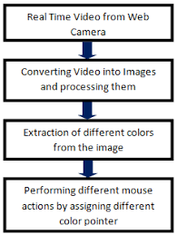
Flow Chart

Slide 8
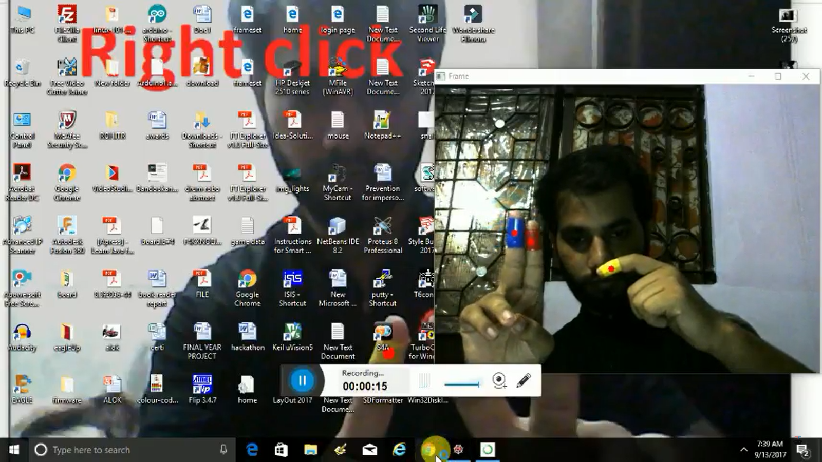

Slide 9
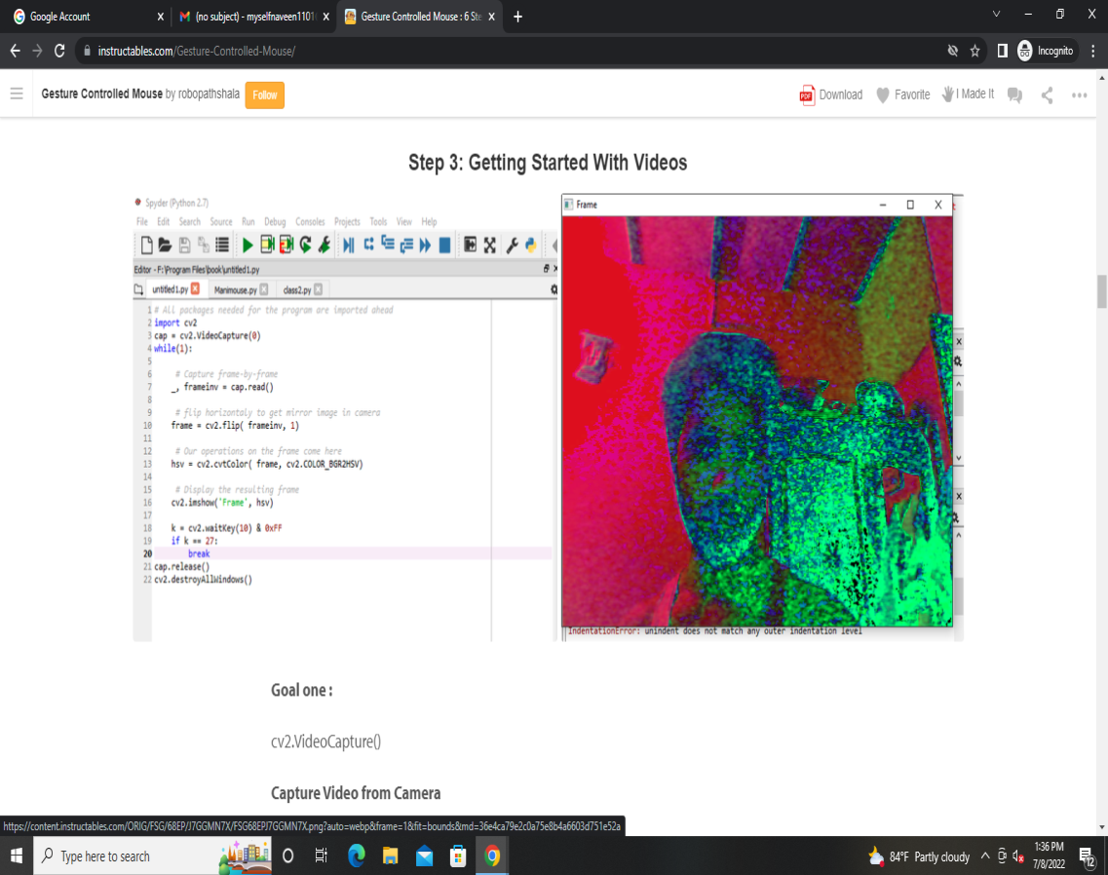

Slide 10
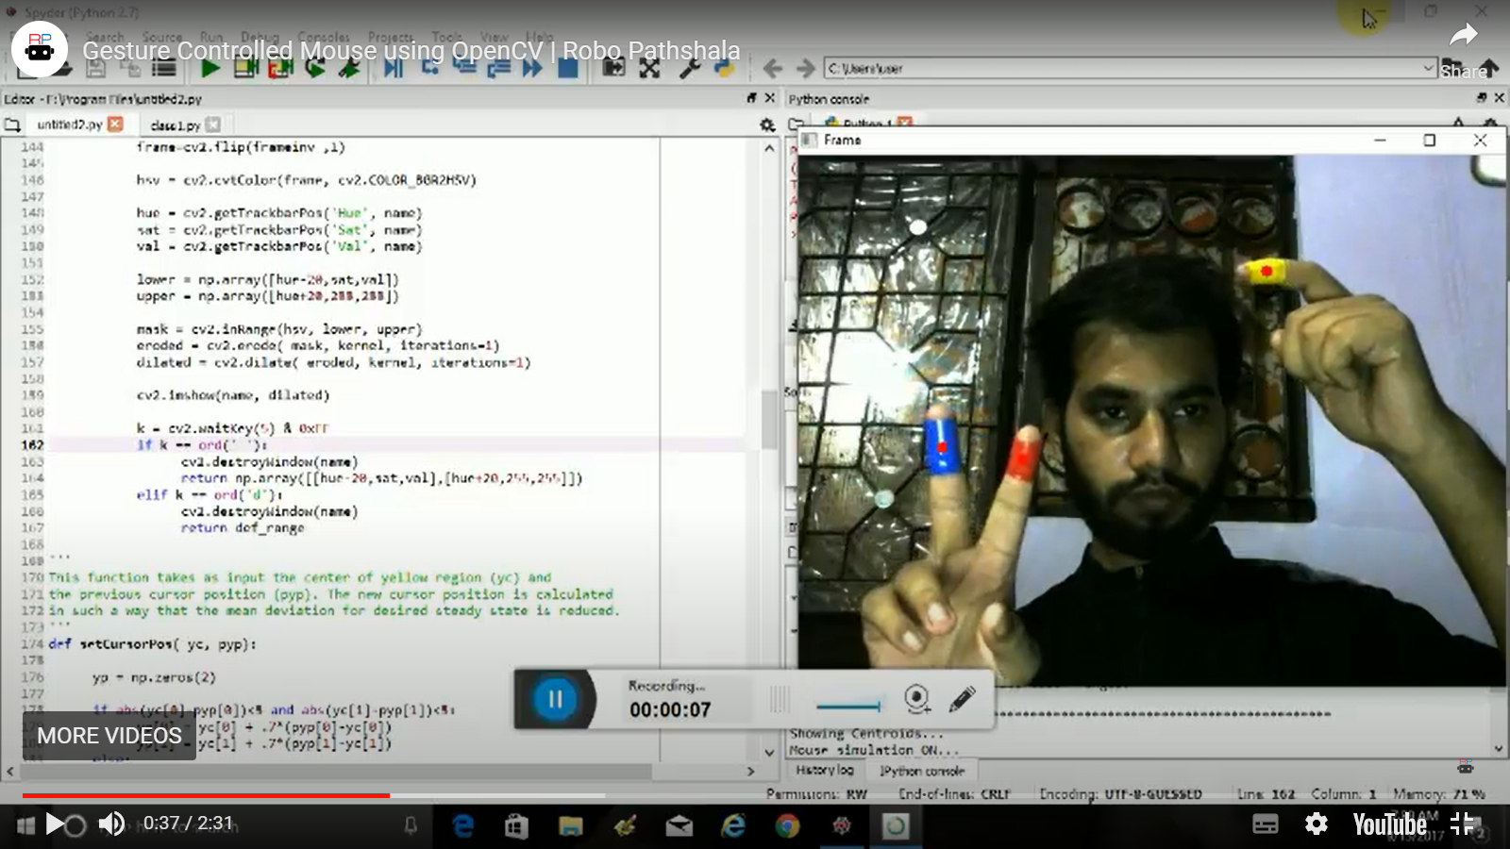

Slide 11
